Slide 1
《英语国家社会与文化入门》(下册）
The Society and Culture
of Major English-Speaking Countries
Introduction
(Book Two)

Slide 2
The United States of America Unit 8 Social Problems in the United States

Slide 3
Quiz
Give the English and a brief explanation for the following:
1 底层黑人群体
2 贫穷作为一个社会问题
3 有社会等级的美国社会
4 毒品作为一个社会问题
5 白领犯罪
6 政府的滥用权力
7 公司的滥用权力
8 理查德•尼克松

Slide 4
Focal Points
racial problems
inequality in American society
discrimination against blacks
the black "underclass"
poverty as a social problem
drug abuse
social costs of drug abuse
crime
the profile of a typical criminal
racial prejudice in the high rate of arrests
white-collar crime
the abuse of power by government
the abuse of power by corporations

Slide 5
This Unit Is Divided into Five Sections
Racial Problems
Poverty
Drug Abuse
Crime
The Abuse of Power by Government and Corporations

Slide 6
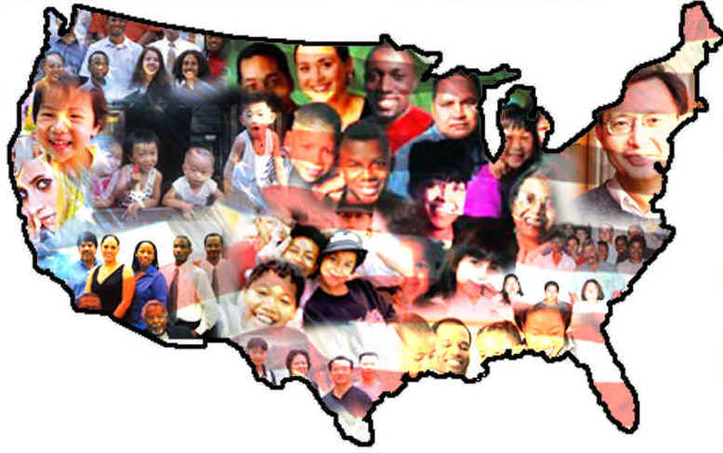
I. Racial Problems
The United States is primarily a nation of immigrants.
It contains many racial and ethnic subcultures with their own distinctive characteristics.
These differences have contributed to racial conflicts that have been a persistent social problem in US society.

Slide 7
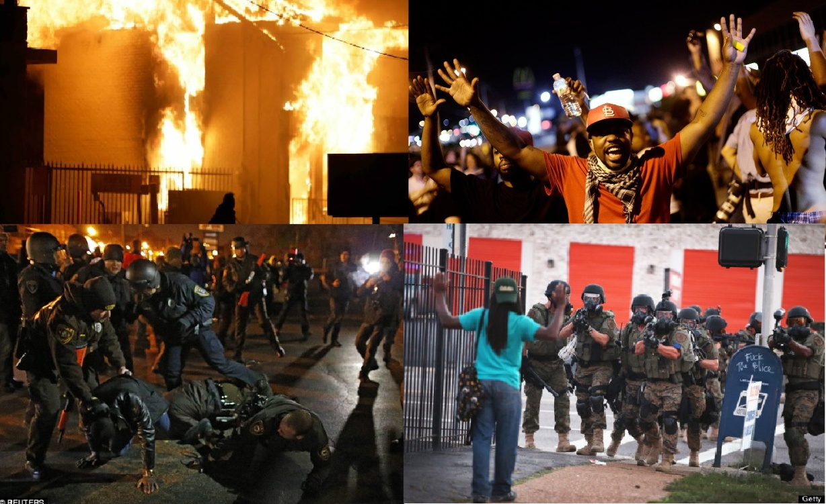
There is power, wealth, racial and ethnic inequality.
Minority people have been excluded by formal and informal barriers from full participation in American life.
Race and ethnic relations have been a major concern and source of unrest and tension.
Racial Riots in Los Angeles

Slide 8
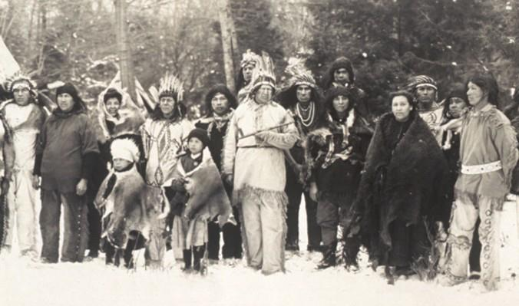
Minority groups -- the blacks, Native Americans, the Hispanics, and Asian Americans.
Minority groups are suffering from racial discrimination and injustice.
The Plight of the Native Americans

Slide 9
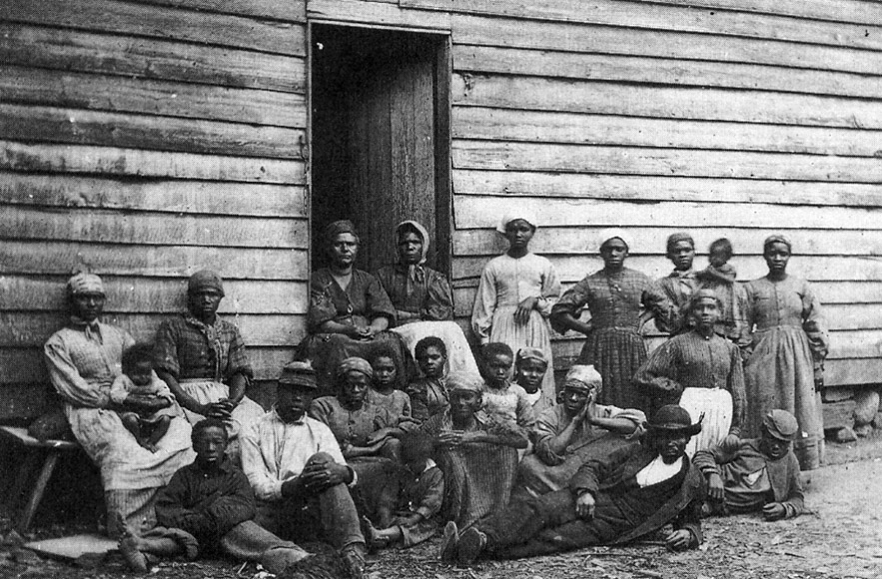
The Blacks / Afro-Americans
The early times:
The first Africans were brought to North America by slave trade.
The myth of their racial inferiority was propagated as a justification for their continued subjugation.
American slavery

Slide 10
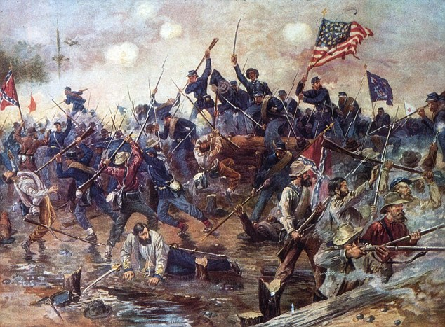
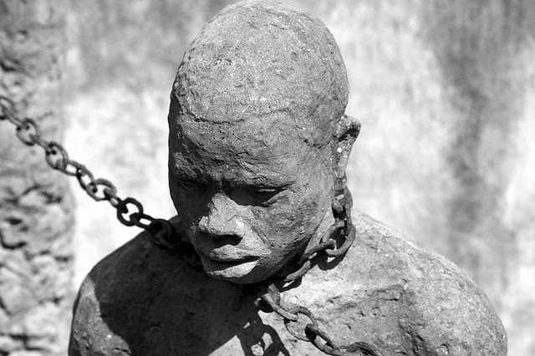
The Civil War – end of slavery
The13th Amendment to the Constitution in 1865 abolished slavery.
Many states passed segregation laws to keep the races apart in public facilities.
Blacks were denied the right to vote.

Slide 11
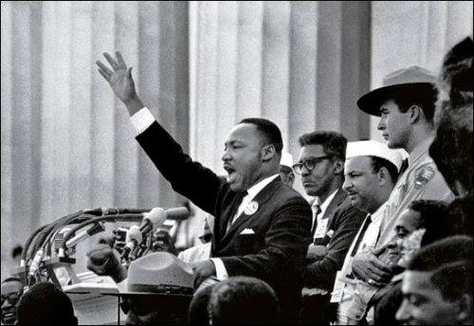
The Civil Rights Movement in the 1960s
• To end segregation laws and fight for the equal rights for the colored people;
• Afro-Americans began to have feelings of pride -- "black is beautiful";
• Blacks should coexist with other groups in a plural society.
Martin Luther King addressed a crowd

Slide 12
The current status of Afro-Americans
-- a mixed picture
The elimination of legal barriers has been a major gain, but institutionalized discrimination is still rife.
They have achieved considerable educational gains.
Median family income of blacks rose but the income gap between the blacks and the whites has widened.
The political influence of blacks is increasing, and blacks are moving into national government, the business world and the media. E.g. Barack Obama.
However, many blacks are pessimistic about progress in race relations.
Urban ghettos still contain a permanently impoverished black “underclass”.

Slide 13
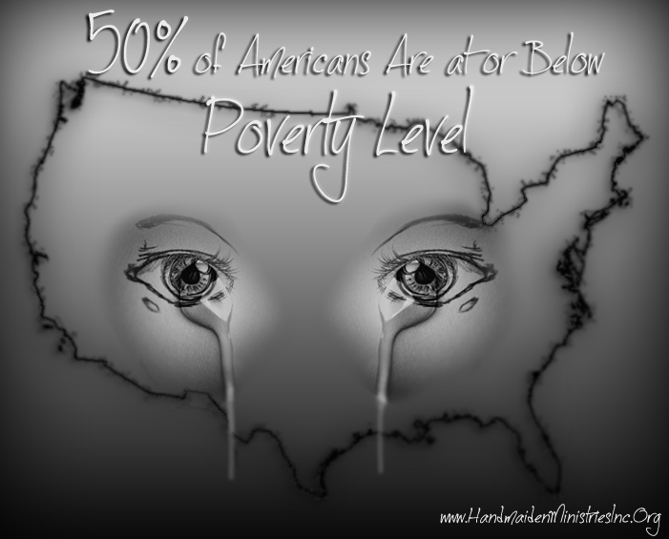
II. Poverty
A considerable number of Americans are still living at or below the official poverty line.
Social services in the U.S. are not as good as those in most industrialized societies.
The affluent majority sometimes seems indifferent to the problems of the poorest section of the population.

Slide 14
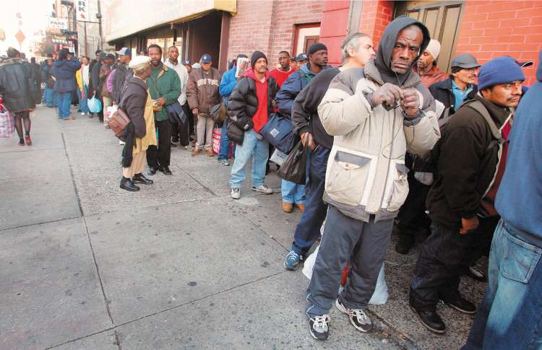
Poverty is a social problem
-- greater susceptibility to disease, alcoholism, victimization by
criminals, and mental disorders;
-- unstable marriages, slum housing, illiteracy, inadequate medical
facilities, and shortened life expectancy;
-- low self-esteem, despair, and stunting of human potential.
People lining up for a warm bowl of soup

Slide 15
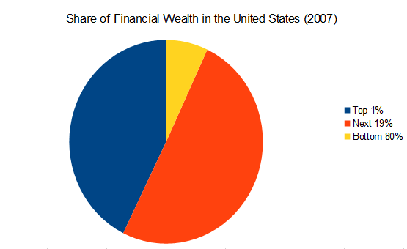
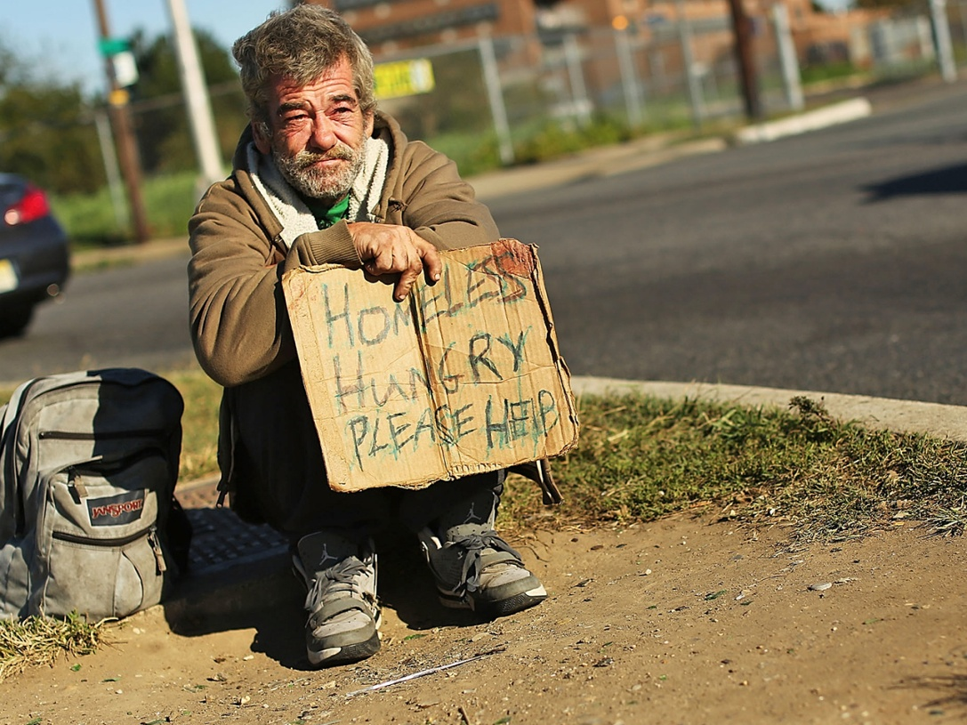
The problem of poverty is aggravated
because of the unequal distribution of
wealth and income in American
society.
It raises serious moral questions and
creates fierce conflicts of interest
and political controversies.

Slide 16
III. Drug Abuse
Drug abuse is one of the most challenging social problems because it has a wide range of social costs.

Slide 17
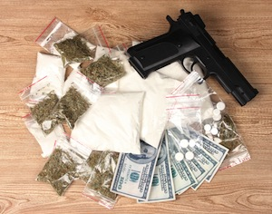
Drugs and crime
There is a strong association between some forms of drug use and crime.
-- most heroin addicts have to steal to buy heroin;
-- users of illegal drugs have to rely on criminal networks for drugs.
-- criminal syndicates have been involved in the supply of illegal
drugs.

Slide 18
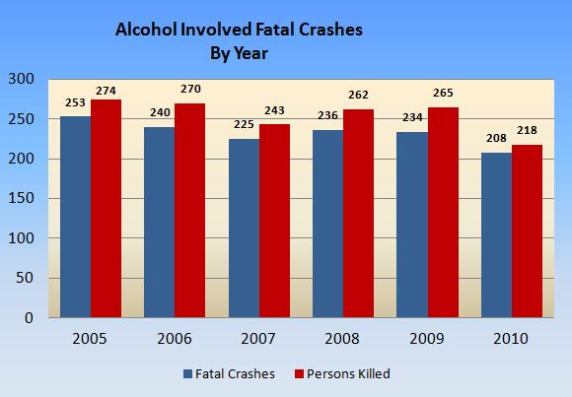
Automobile accidents
Alcohol use is directly responsible for highway accidents and injuries;
The cost of property damage and medical expenses due to alcohol-related automobile accidents totals about $1 billion each year.

Slide 19
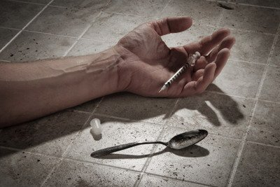
Effect on individuals
Drug dependence affects personal health and safety.
It may affect an individual's life, ranging from the home to the work place to personal relationships with friends.

Slide 20
Economic losses
The cost of alcohol abuse is huge in accidents, medical bill, lost production, and so on.
Society must pay indirect costs to support drug-dependent persons.
-- Treatment and control of drug abuse constitute a major drain
on law-enforcement and other public resources.
-- Chronic drug abusers may end up on the welfare rolls.

Slide 21
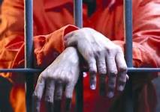
IV. Crime
• Crime is a serious social problems – “number one enemy”.
• Those arrested for crimes are likely to be male, young, a member of a racial minority, and a city resident.
• Crime among females has been increasing.

Slide 22
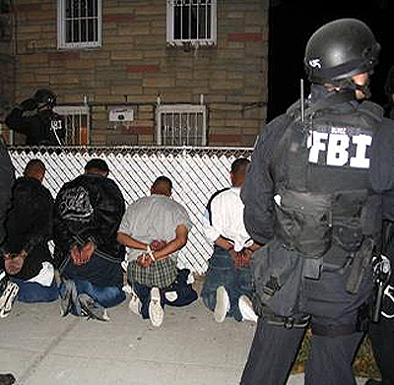
Young people appear to commit far more than their share of crime, including the crimes that are classified by the FBI as most serious.
Members of racial minority groups have a disproportionately higher rate of arrests.
the experimental study of “Joe Cut”

Slide 23
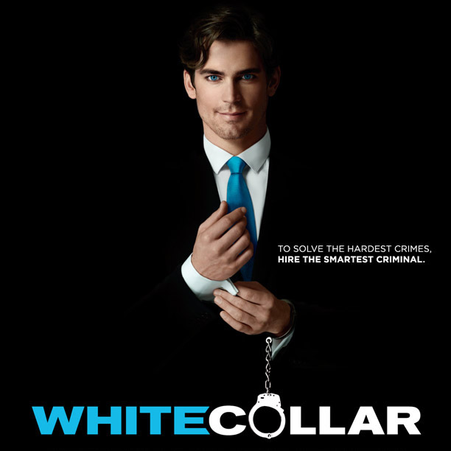
White-collar crimes
crimes typically committed by
higher income groups -- fraud,
false advertising, corporate
price fixing, bribery,
embezzlement, industrial
pollution, tax evasion, and
so on.

Slide 24
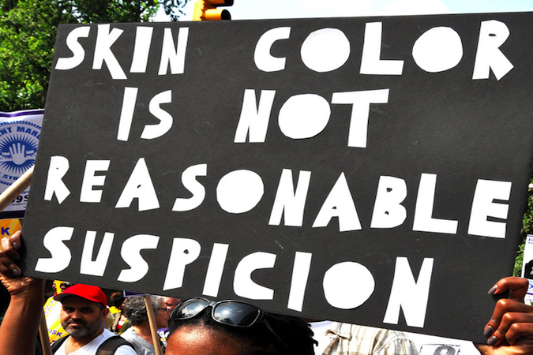
Statistics that overlook white-collar crimes are affected by police reporting practices, many crimes are unreported.
The poor, the undereducated, and minorities have been the victims not only of selective law enforcement, but also of misleading statistics on crime.

Slide 25
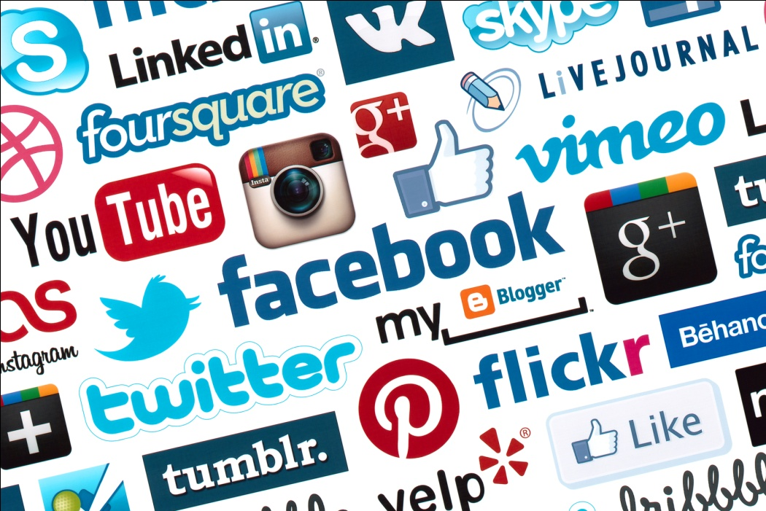
V. The Abuse of Power by Government and Corporations
American lives are dominated by
-- the public organizations, primarily government agencies;
-- the private organizations, primarily business corporations.
The lack of public answerability of these large organizations has
become a major social problem.

Slide 26
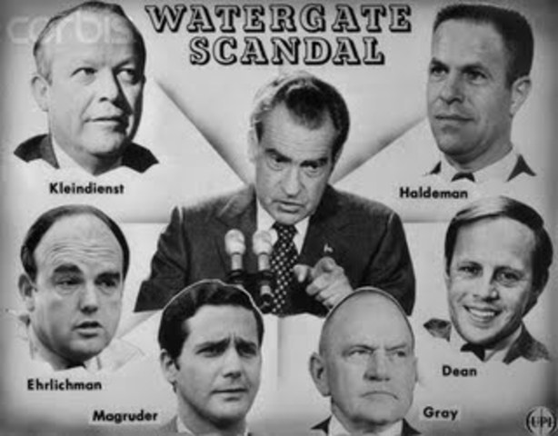
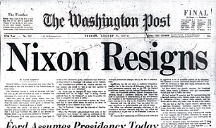
The Watergate Scandal
Government and corporations are widely distrusted in the United States.
Distrust of government reached its height during the Watergate affair.

Slide 27
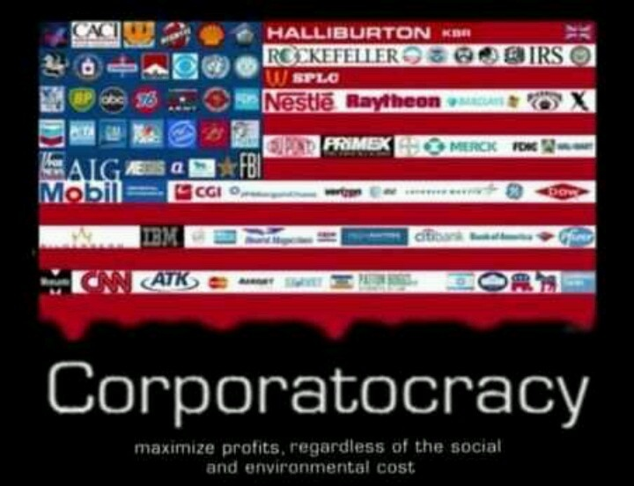
Private corporations
are widely believed to be more concerned with their own profits than with social responsibility, and the quality or price of their products, or the truth of their advertising.

Slide 28
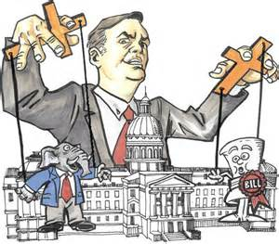
Lobbyists
Large corporations maintain professional lobbyists in Washington, D.C. to influence public officials behind the scenes.
Many Americans believe that “government is run by a few big interest groups looking after themselves.”

Slide 29
Questions for Discussion
The author says that the United States was founded on the principle of human equality, but in practice the nation has fallen far short of that ideal. Illustrate this point with what you have learned from this unit.
Use examples from this unit to support the author’s argument that American society is a stratified one, in which power, wealth and prestige are unequally distributed among the population.
Discuss the origins, development and current situation of the black-white relations in the United States.
What does poverty mean in the United States? Why is poverty a social problem in America?
Why does the drug issue always excite strong emotions among Americans? Why is it perceived as a major threat to American society?

Slide 30
The End
高等教育出版社
2015

